Slide 1

SHRAVANI SAWANT
DECODING SUICIDE PATTERNS IN THE UNITED STATES:
A MULTI-FACTORIAL EDA WITH INSIGHTS
Course: SYS 624: Data Exploration & Informatics for Engineering Management
Instructor: Dr. Carlo Lipizzi
Semester: Spring 2025
Date of Submission: April 26, 2025

Slide 2


ABSTRACT SUMMARY
Understanding Suicide Trends (2005–2022)
Multidimensional exploration across age, gender, race, education, geography, seasons.
Combined statistical analysis with creative visualizations.
Policy-driven insights: linking data patterns with prevention frameworks.
Aimed to inform public health officials, mental health advocates, and policymakers.

Slide 3
INTRODUCTION &
WHY THIS STUDY MATTERS
Suicide rates have been rising in the U.S. since the late 1990s.
Existing studies lacked dynamic, visual, and multidimensional analysis.
Goal: Connect data to authentic intervention strategies.
Core Dataset: full_data.csv + enriched with external CDC/Kaggle datasets.

Slide 4
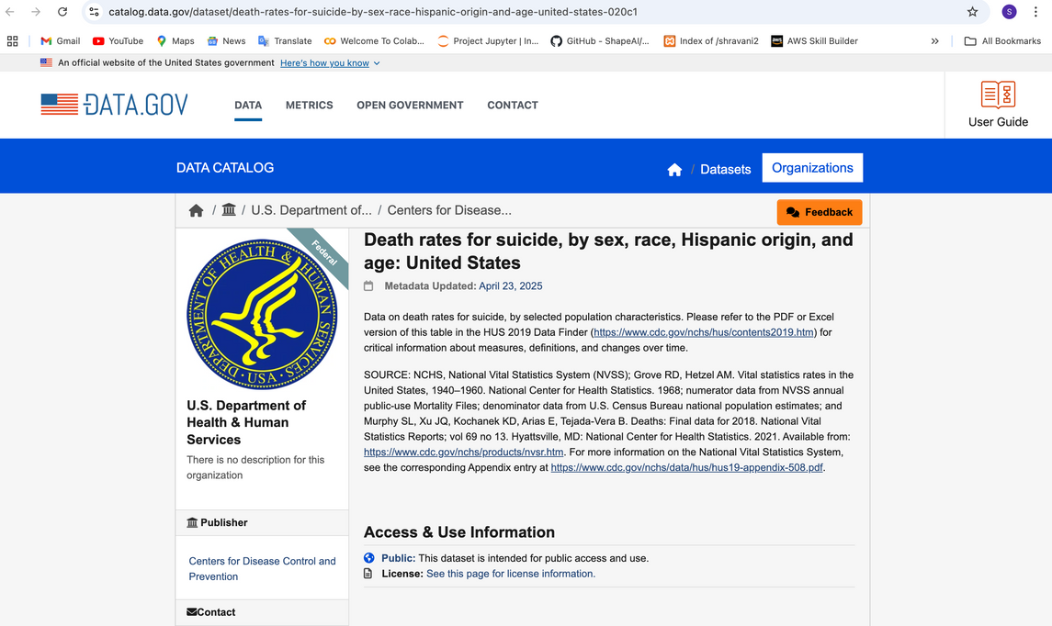
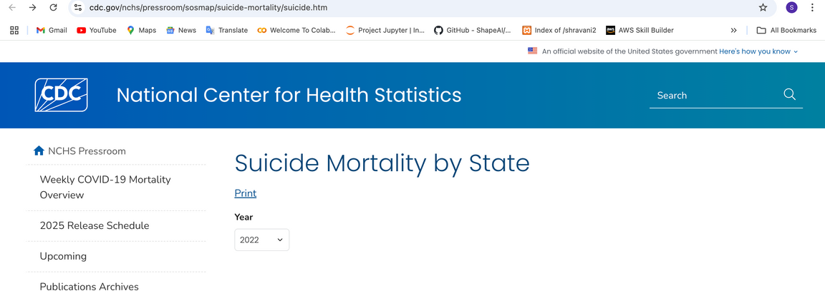
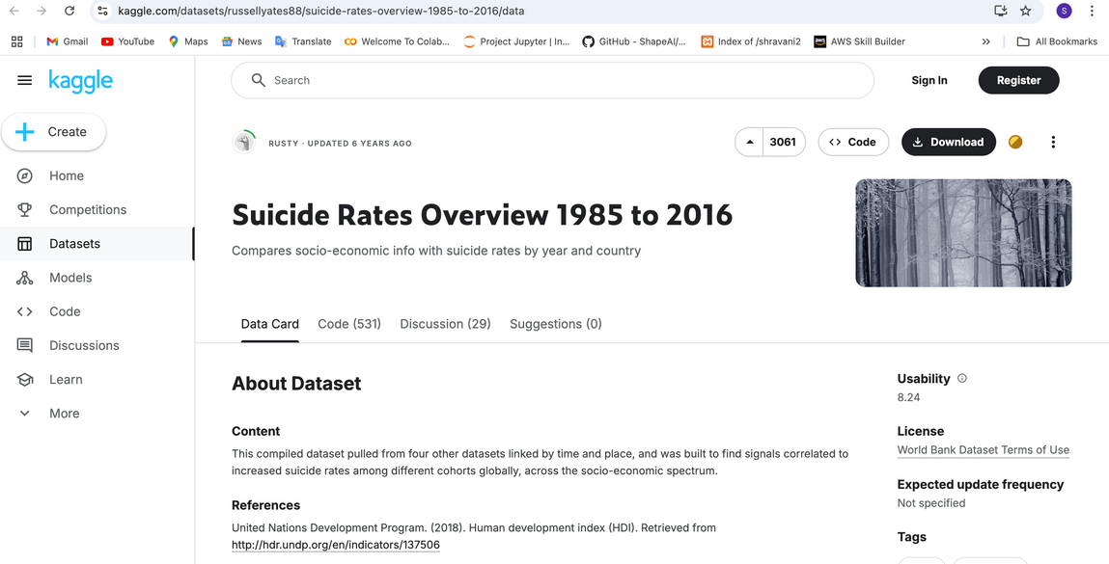
FOUNDATIONS & GAPS
CDC Reports: Highlighted sex, age, state variations.
Zero Suicide Model: Advocated system-wide mental health reforms.
Google Trends: Digital signals correlated with suicide spikes.
Gap: Need for interactive, modular visual storytelling.

Slide 5
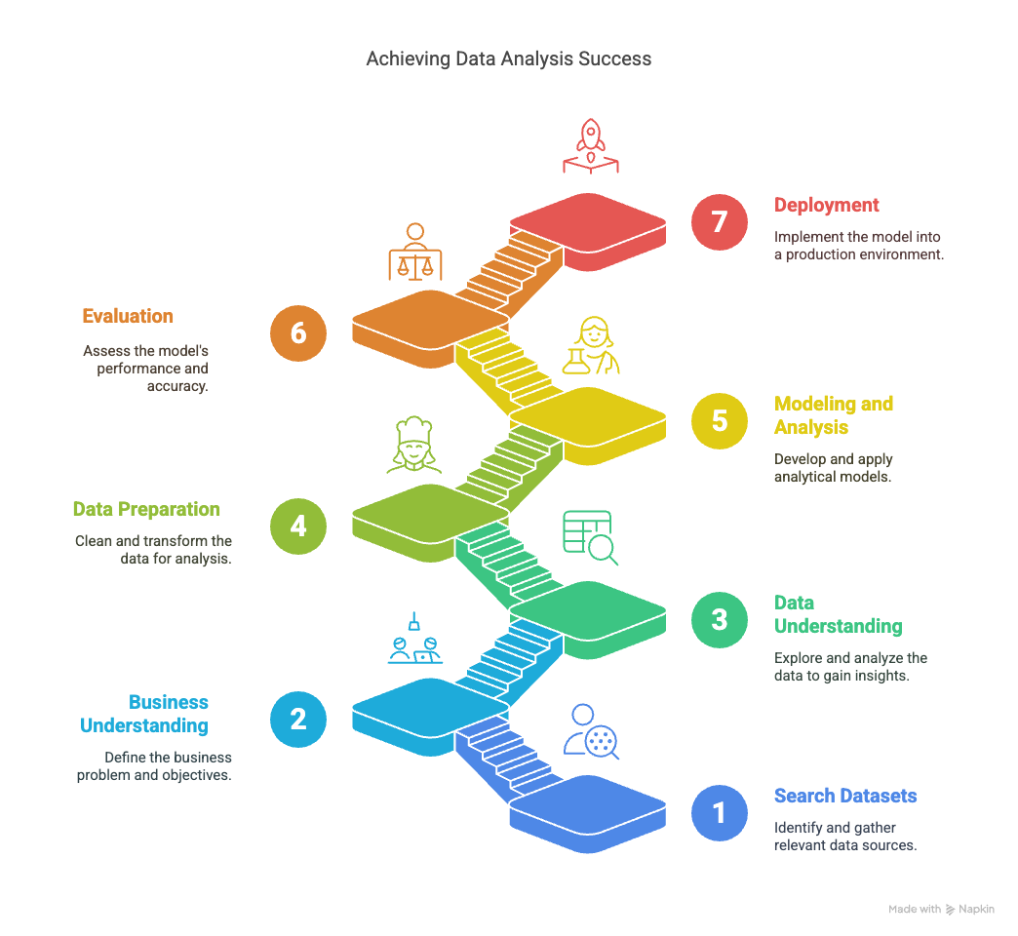
METHODOLOGY OVERVIEW
CRISP-DM Model phases: Understanding → Preparation → Analysis → Deployment.
01
Question-wise Modular Analysis:
Q1 to Q11 separate scripts.
02
Combination of static and animated visual storytelling.
03

Slide 6
PRIMARY & SUPPLEMENTARY DATASETS
full_data.csv — U.S. Suicide Cases (2012–2014).
01
Kaggle Suicide Rates Overview:
Global trends (1985–2016).
03
CDC Suicide Mortality Map : State-level data (2005–2022).
02
Data.gov Death Rates:
Race × Age × Sex patterns.
04

Slide 7

DATA CLEANING AND PREPARATION
Filtered "Suicide" intent only.
Created age groups, seasons, region tags.
Normalized year-wise, state-wise, and global datasets.
Consolidated multiple sources for enriched context.

Slide 8
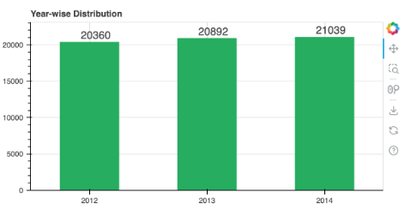
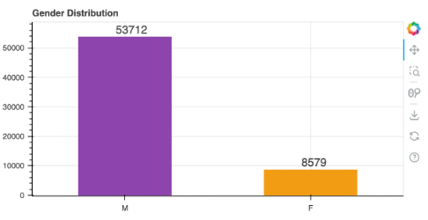
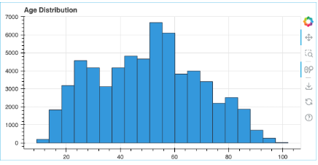
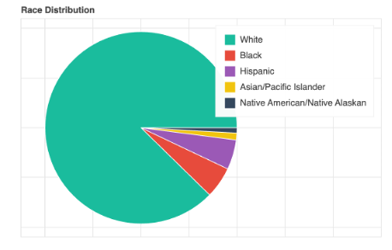
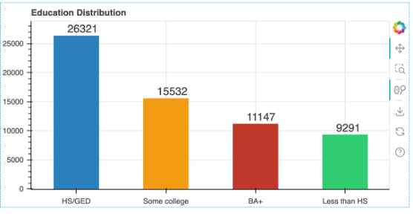
PRELIMINARY DATA ANALYSIS
(SUMMARY)
01
Male suicides: 86% of cases.
Peak age group: 50–59 years.
02
Race: 87% suicides among White individuals.
03
High school graduates most vulnerable.
04

Slide 9
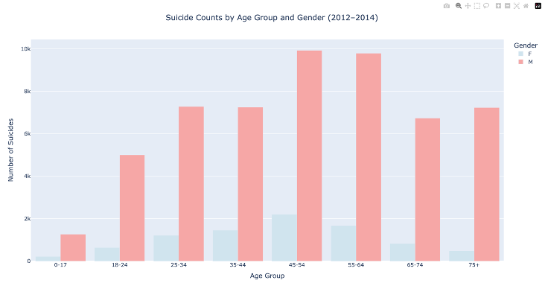
Q1
AGE AND SUICIDE RISK
Suicide peaks at 45–64 years.
Males dominate across all age groups.
Youth suicides (below 18) relatively rare but rising.

Slide 10
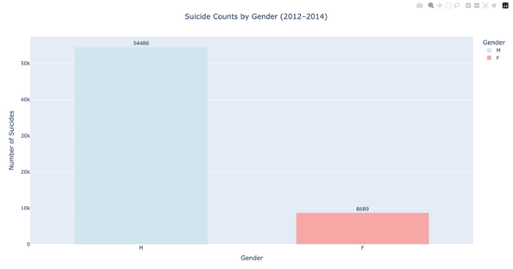
Q2
GENDER DISPARITIES
Males account for 86.2% of all suicides
01
Despite more female attempts, male deaths are higher.
02
Need for gender-sensitive intervention programs.
03

Slide 11
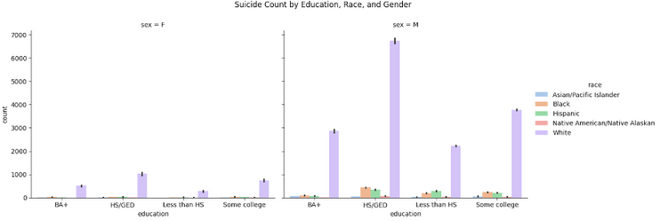
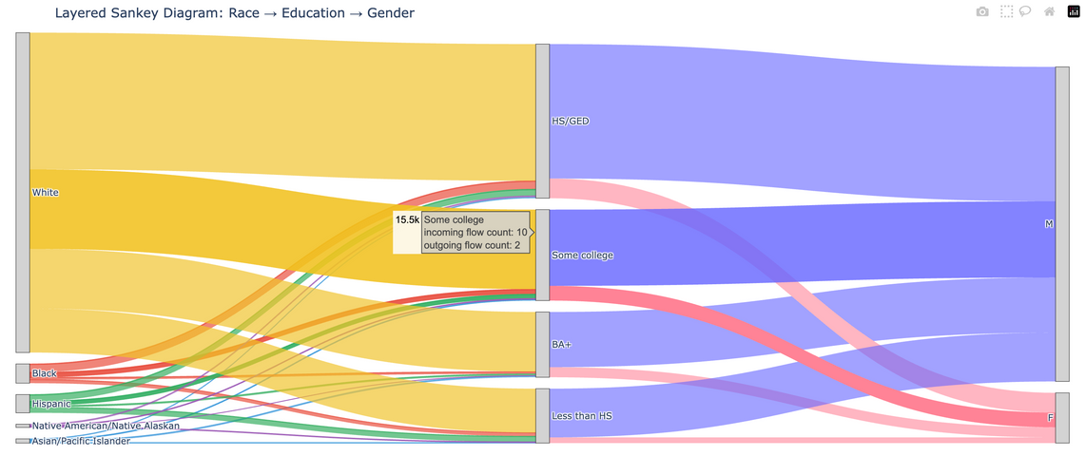
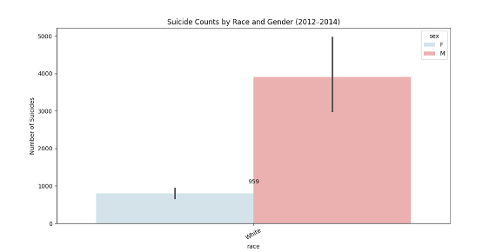
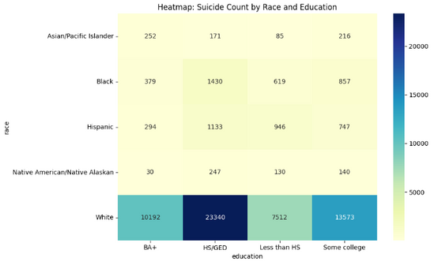
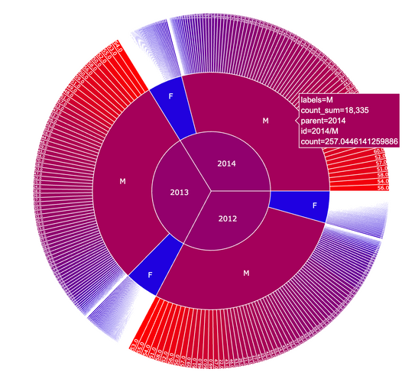
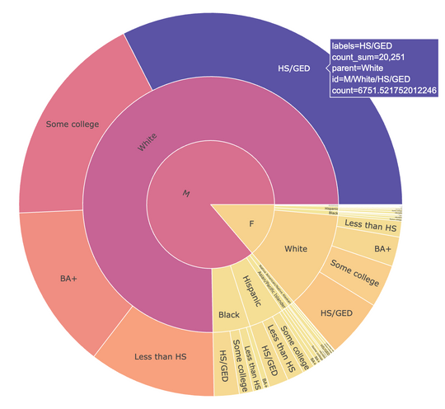
Q3 COMBINED FACTORS (SEX, RACE, EDUCATION)
White Males with HS/GED education dominate suicide counts.
01
Educational attainment strongly linked with risk levels.
02
Intersectionality matters: race, gender, and education converge.
03

Slide 12
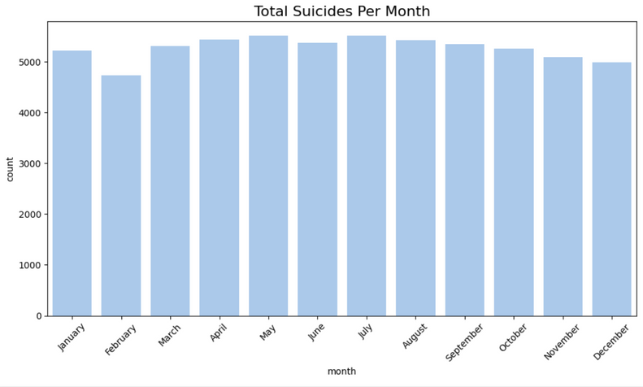
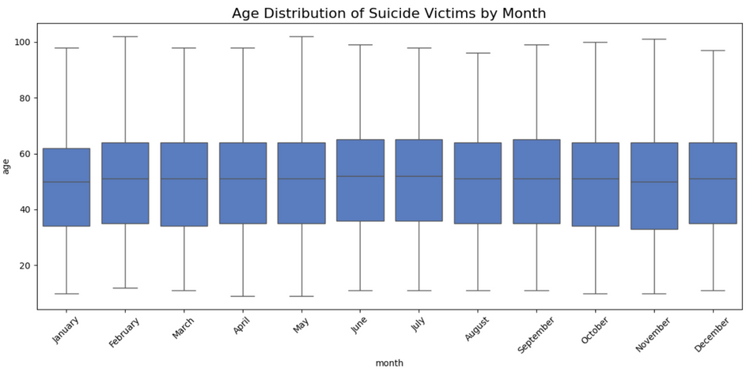
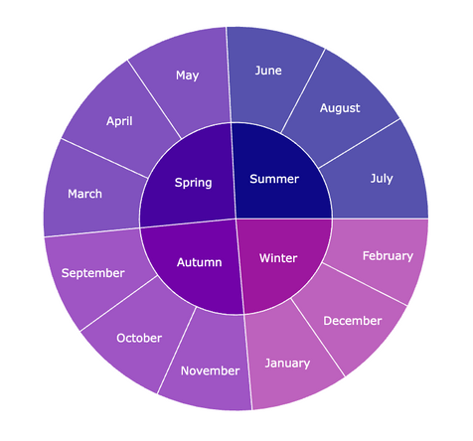
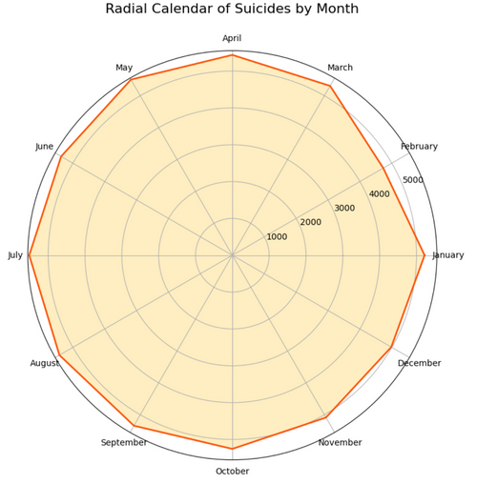
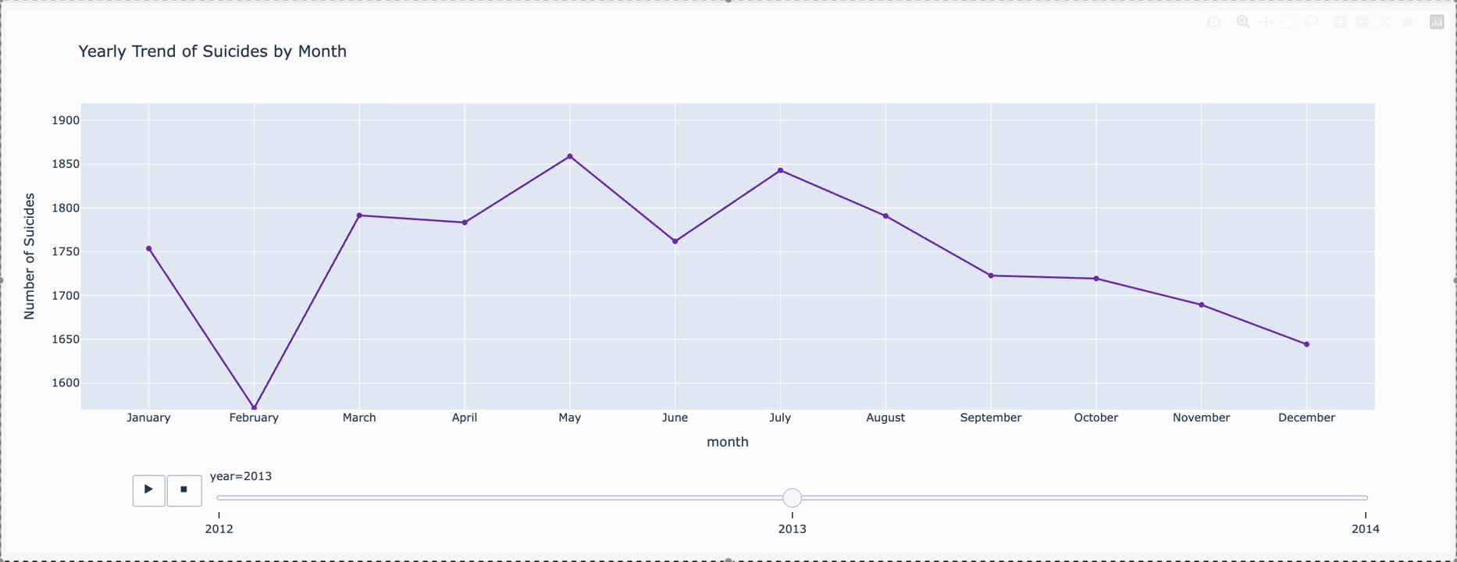
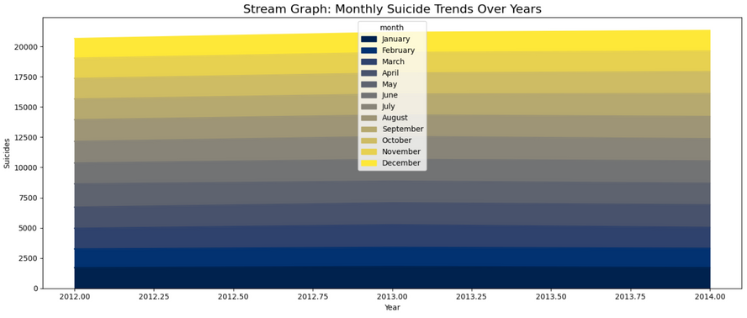
Q5
MONTHLY/
SEASONAL
TRENDS
Peaks in May–July
(Late Spring, Summer).
Winter
(December–February) shows decline.
Seasonal preventive campaigns recommended.

Slide 13
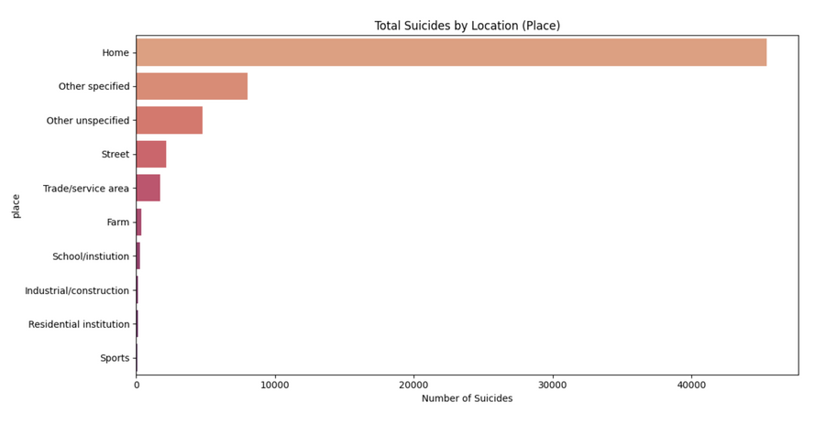
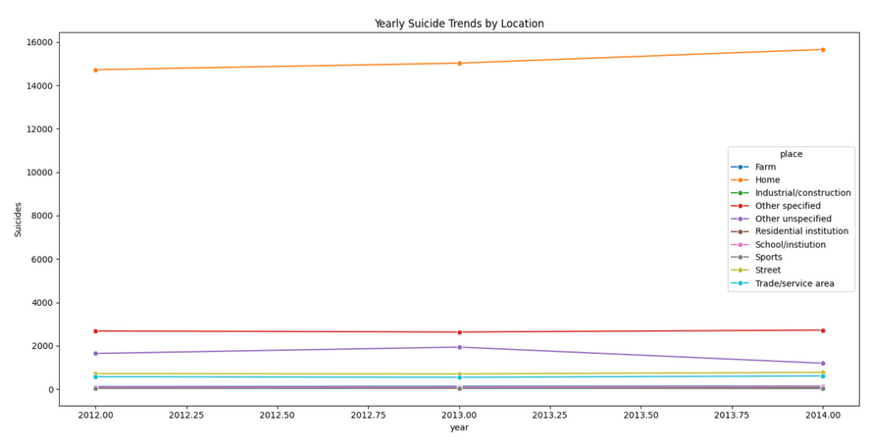
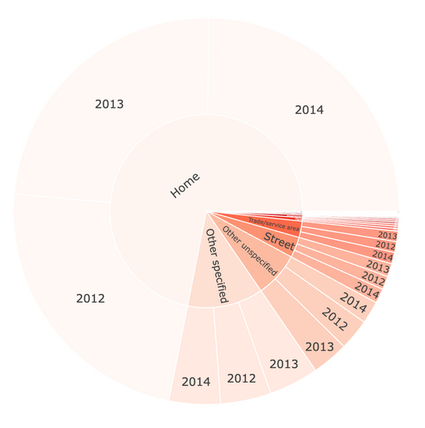
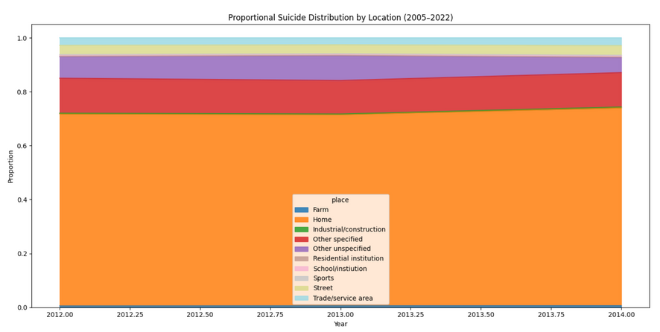
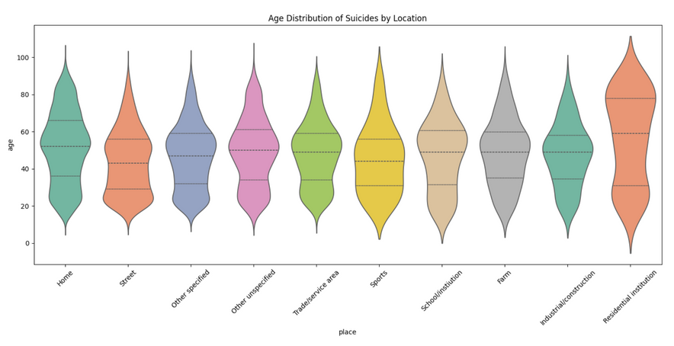
Q6
SUICIDE BY LOCATION
Environmental Risk Factors
Home is the most common place (~73% cases).
Age shift: Older adults prefer home settings.
Institutional suicides are rare but serious.

Slide 14
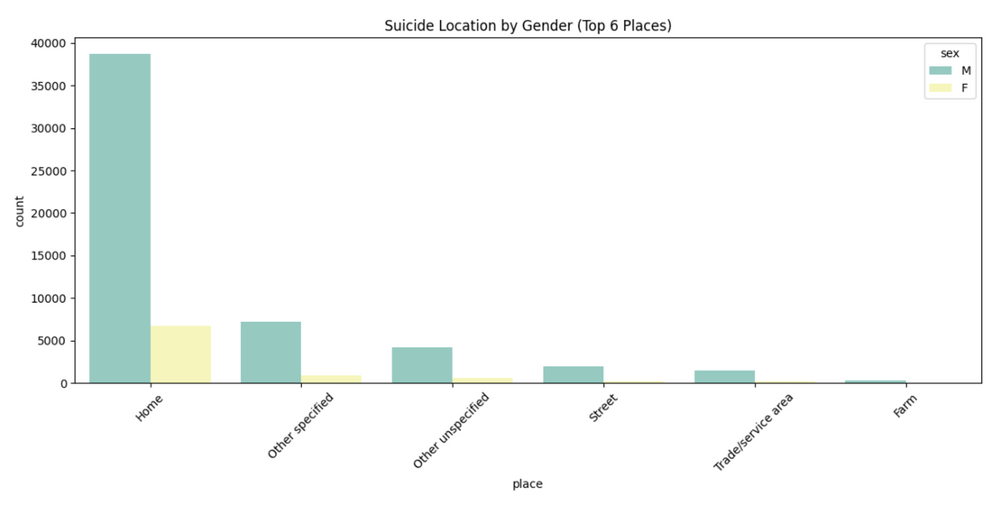
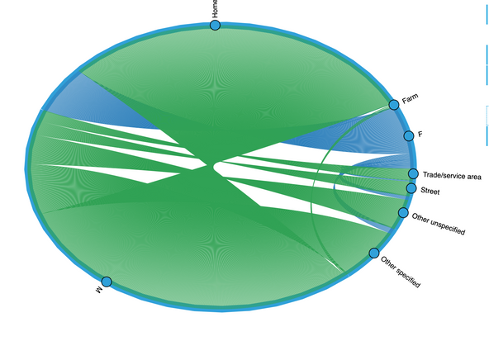
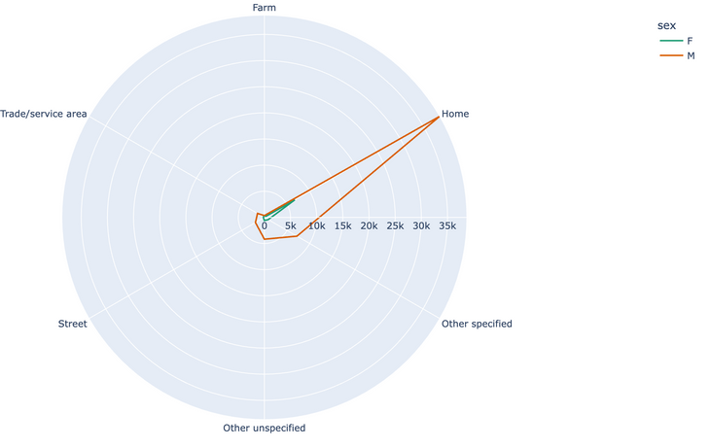
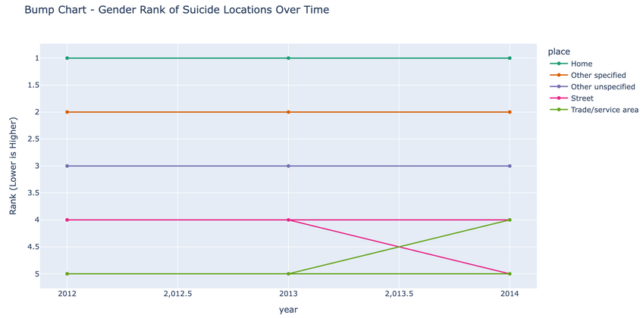
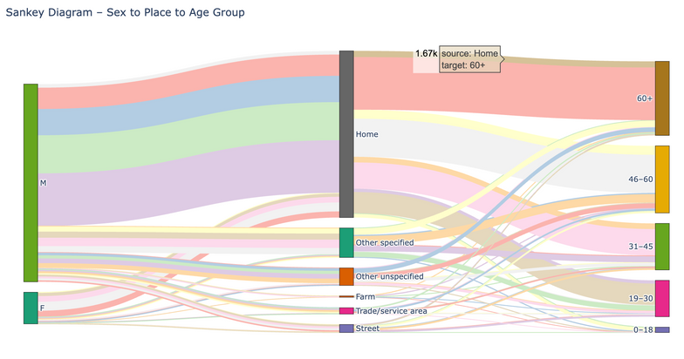
Q7
LOCATION X DEMOGRAPHICS
01
Gendered Place Patterns
Men dominate all places; women concentrated at home.
02
Older men (60+) dominate home-based suicides.
03
Young males visible in public place suicides.
04

Slide 15
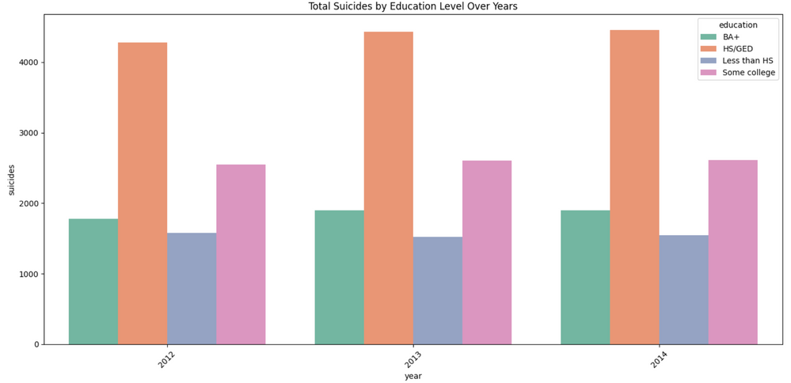
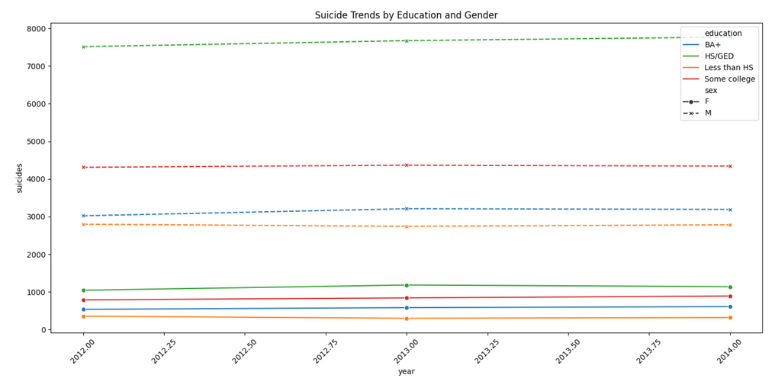
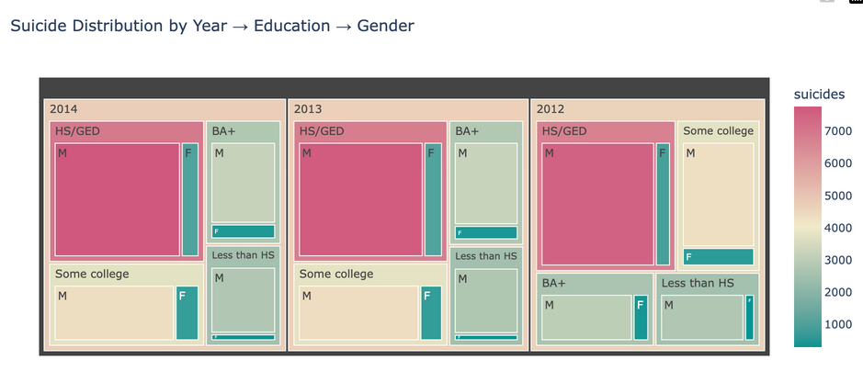
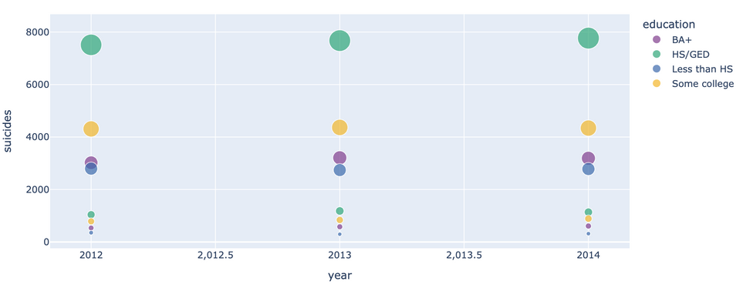
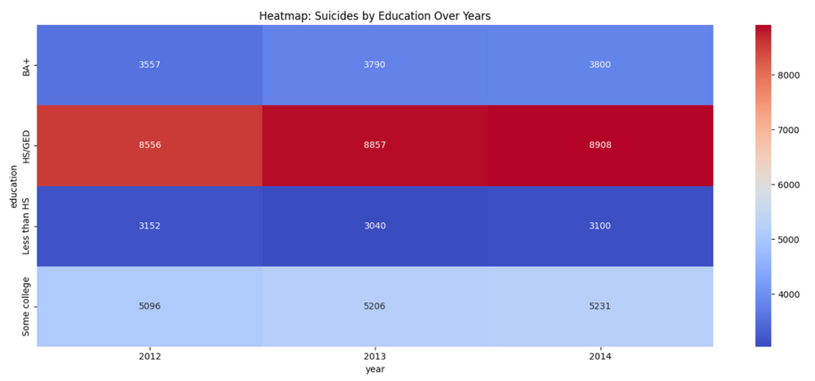
Q8
EDUCATION AND
SUICIDE
HS/GED group shows highest suicide burden.
01
BA+ education appears protective.
02
Economic stress likely a driving factor.
03

Slide 16
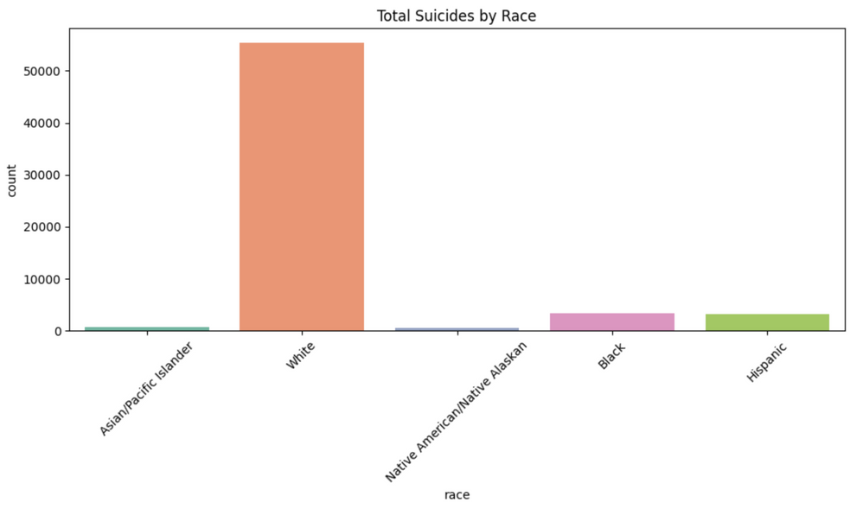
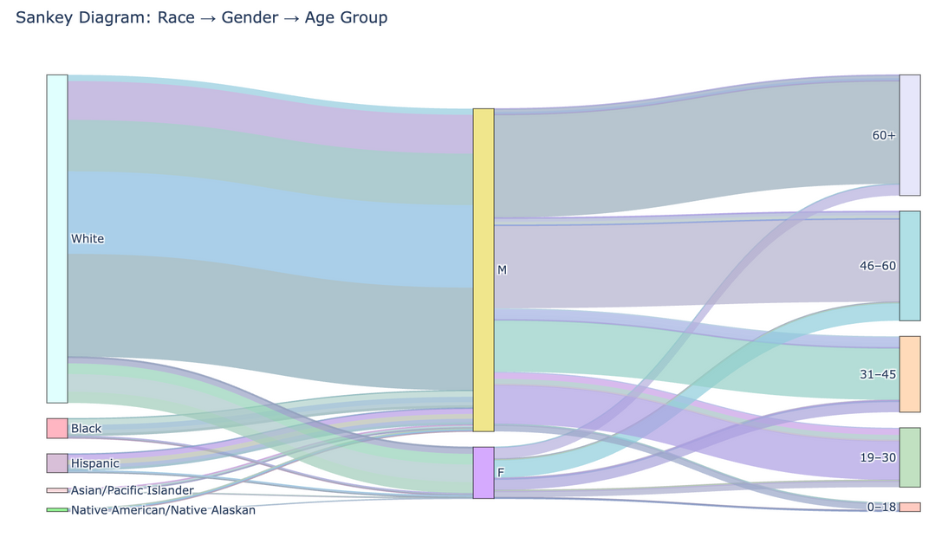
Q9
RACE,
GENDER &
SUICIDE
Race-based Differences
White males, especially older, highest risk.
Black and Hispanic males at mid-age (19–45) riskier.
Racial health inequalities need policy focus.

Slide 17
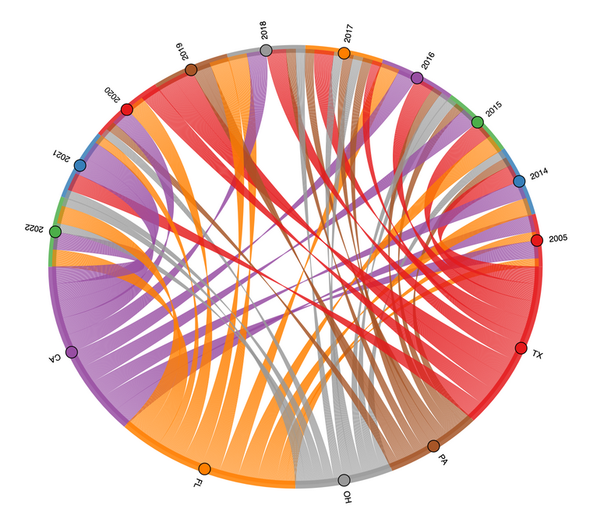
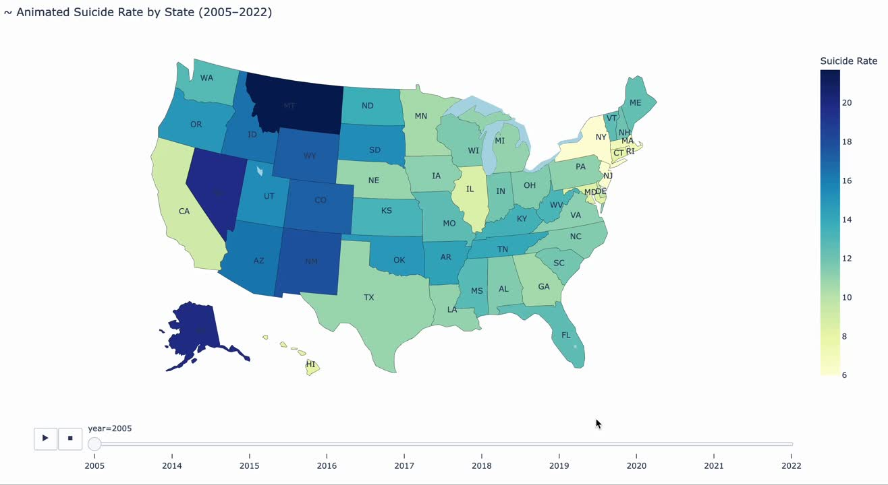
Q4
STATE LEVEL
SUICIDE TRENDS
Highest suicide rates: Montana, Wyoming, Alaska.
Absolute deaths highest in CA, TX, FL.
Western rural states most vulnerable.

Slide 18
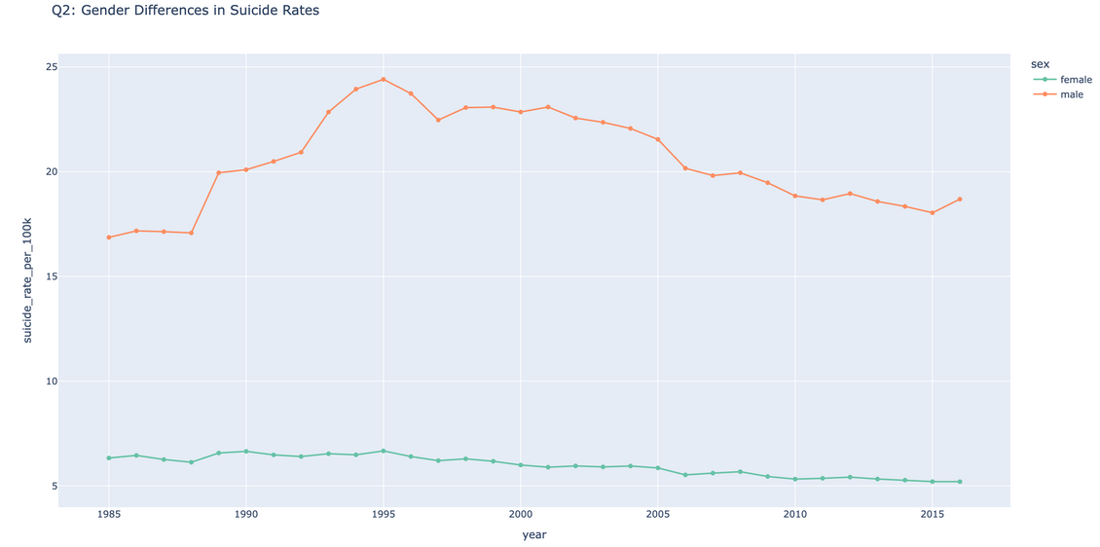
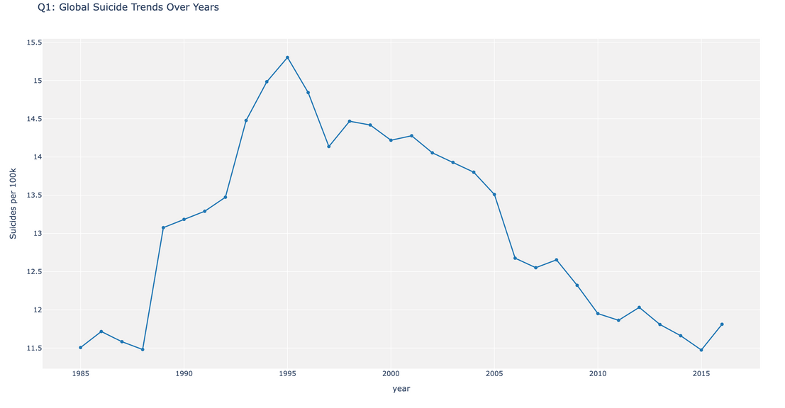
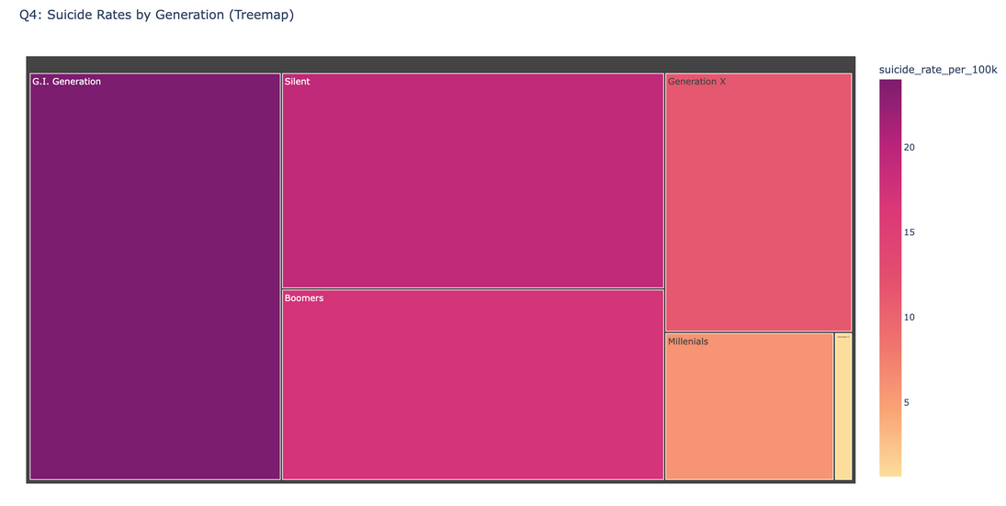
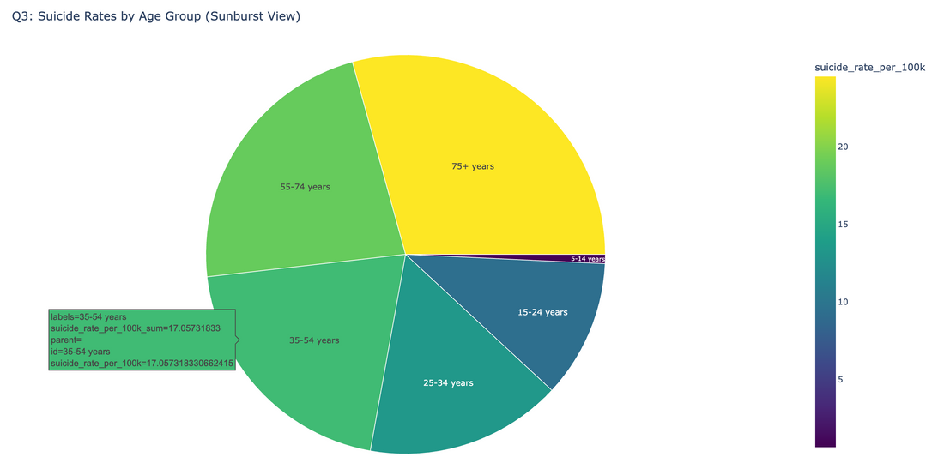
Q10
GLOBAL SUICIDE TRENDS
01
Global Context
Global peak in mid-1990s; decline post-2000.
02
Males globally 3x riskier than females.
03
GDP ≠ lower suicide rates: policy more important.
04

Slide 19
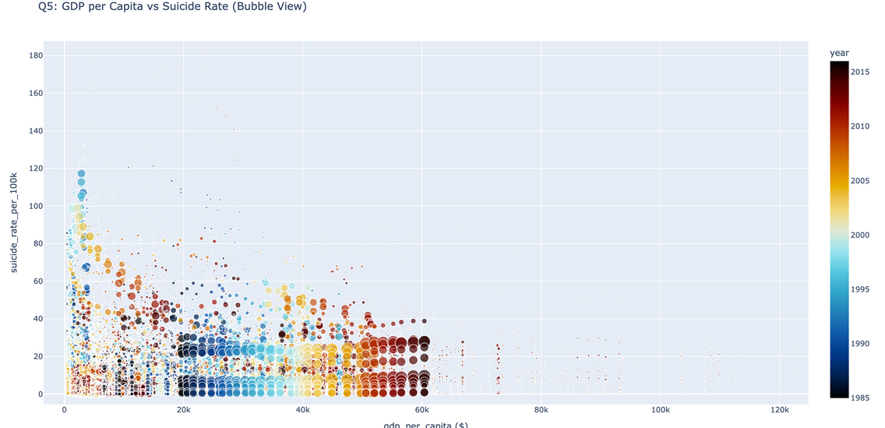
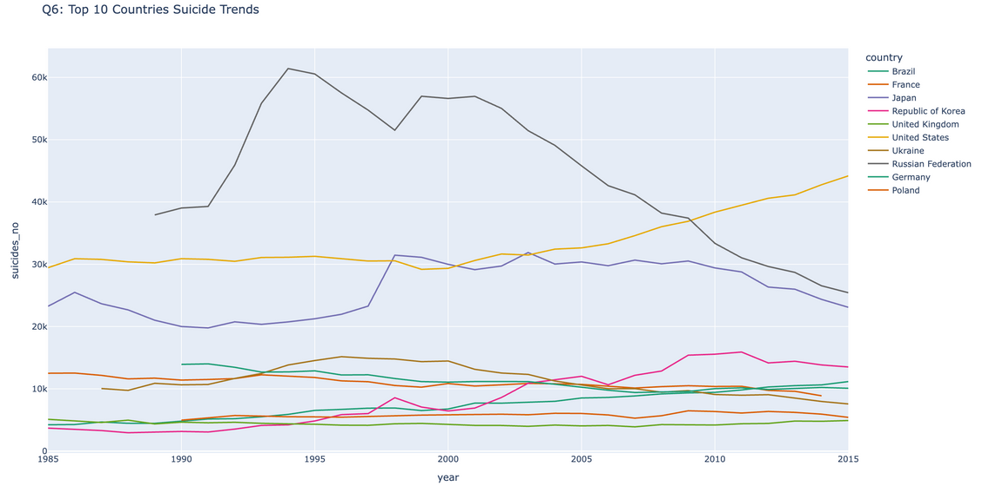
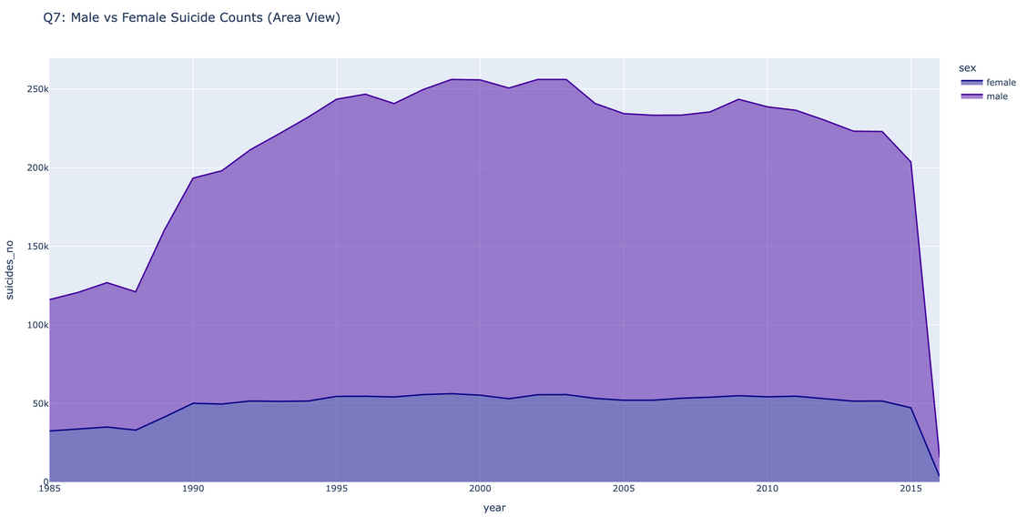
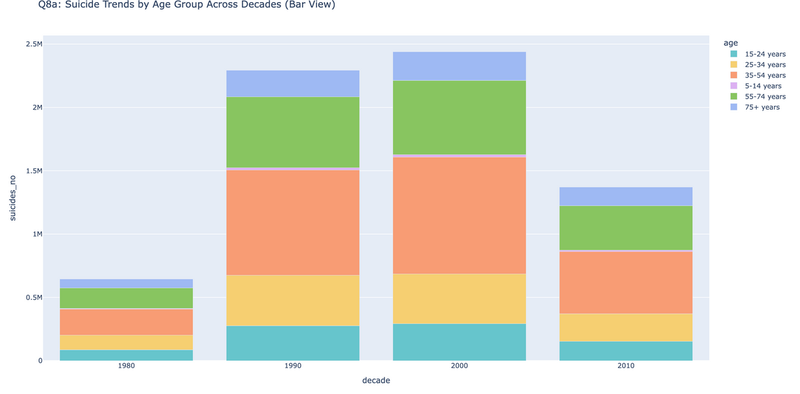


Slide 20



Q11
U.S DEath RATE PATTERNS
Emerging Risks
Seniors 85+ still highest death rates.
Rising trend among youth
(15–24) post-2010.
Persistent gender gap: males at 3–4x higher risk.

Slide 21






Slide 22
DISCUSSION &
PRACTICAL IMPLICATIONS
Major Learnings
Male mental health interventions are critical.
Seasonal, geographical, and educational vulnerabilities exist.
Intersectional strategies: age, race, education must guide policy.
Need for dynamic, targeted, localized preventive actions.

Slide 23
CONCLUSION
Final Takeaways
Suicide is a multi-dimensional, evolving crisis.
Data-driven visual storytelling reveals hidden patterns.
Public health models must adapt to changing demographic vulnerabilities.
Ongoing monitoring, education, and policy reforms are crucial.

